Slide 1
Data Mining Classification, Clustering & Association
Notes:
1

Slide 2
Agenda
Introduction to Data Mining
What is Data Mining,
Classification
Decision tree
Naïve Bayes Classifier
Clustering
K-means Clustering
Agglomerative
Frequent Pattern Mining
Apriori
FP Growth
2

Slide 3
Introduction
Motivation
Data explosion problem
Automated data collection tools and mature database technology lead to tremendous amounts of data stored in databases, data warehouses and other information repositories
Need to convert such data into Information and Knowledge.
3
3

Slide 4
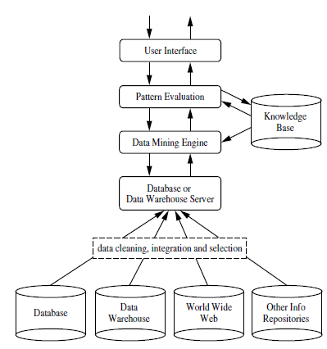
Introduction
DM Definition
Finding Hidden Information in Database : MHD
Knowledge refers to stored information or models used by a person or machine to interpret, predict and appropriately respond to the outside world. (Haykin)
4
Data explosion problem : Need to convert such data into Information and Knowledge.
Notes:
4

Slide 5
Introduction
DM Definition
Process of semi-automatically analyzing large databases to find patterns that are:
valid: hold on new data with some certainity
novel: non-obvious to the system
useful: should be possible to act on the item
understandable: humans should be able to interpret the pattern
Finding Hidden Information in Database (MHD).
Also known as Knowledge Discovery in Databases (KDD)
5
5

Slide 6
Introduction
DM Definition
Process of semi-automatically analyzing large databases to find patterns that are:
valid: hold on new data with some certainty
novel: non-obvious to the system
useful: should be possible to act on the item
understandable: humans should be able to interpret the pattern
MHD
Human Interaction
Overfitting
Outliers
Interpretation of results
Visualization of results
Large Datasets
High Dimensionality
DM Issues ?
6
Notes:
6

Slide 7
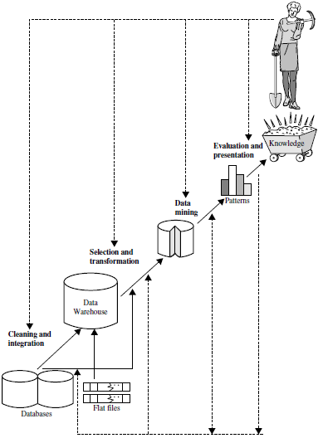
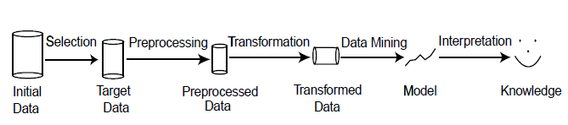

7

Slide 8
Introduction
Data Mining Tasks (Styles of learning)
Data Mining
Predictive
Descriptive
Classification
Clustering
Regression
Summarization
Prediction
Association Rules
Time Series Analysis
Sequence Discovery
8

Slide 9
Classification
Basic Concepts
Classification is a form of data analysis that extracts models describing important data classes.
Data classification is a two-step process, consisting of
A learning step , where a classification model is constructed and
A classification step, where the model is used to predict class labels for given data
9
Notes:
Figure: A system is described by the partial descriptions in terms of the models (formal or semi formal).
From model, either execution or by other means abstract test cases can be derived. Abstract test cases are portable to any implementation platform to generate concrete test cases.
Concrete test cases are used to test implementation of the systems.
Model based testing promotes design driven testing.
This leads to early planning and design of test cases in the development cycle.
As concurrency is the property of he system, concurrency testing may be planned and designed early in the development cycle with the help of models.
UML designs are one of the source of concurrency information at the design level.
With recent trend towards Model Driven Architecture (MDA) \cite{Poole2001}, the choice of UML models is natural source for concurrency information at the design level.
Image source -- http://en.wikipedia.org/wiki/Model-based_testing
9

Slide 10
Classification
Basic Concepts
10
Notes:
Figure: A system is described by the partial descriptions in terms of the models (formal or semi formal).
From model, either execution or by other means abstract test cases can be derived. Abstract test cases are portable to any implementation platform to generate concrete test cases.
Concrete test cases are used to test implementation of the systems.
Model based testing promotes design driven testing.
This leads to early planning and design of test cases in the development cycle.
As concurrency is the property of he system, concurrency testing may be planned and designed early in the development cycle with the help of models.
UML designs are one of the source of concurrency information at the design level.
With recent trend towards Model Driven Architecture (MDA) \cite{Poole2001}, the choice of UML models is natural source for concurrency information at the design level.
Image source -- http://en.wikipedia.org/wiki/Model-based_testing
10

Slide 11
Classification
Basic Concepts
In the first step, a classifier is built : this is the learning step (or training phase), where a classification algorithm builds the classifier by analyzing or “learning from” a training set made up of database tuples and their associated class labels.
A tuple, X, is represented by an n-dimensional attribute vector, X ={x1, x2, …, xn} depicting n measurements made on the tuple from n database attributes, respectively, A1, A2, :…, An.
Each tuple, X, is assumed to belong to a predefined class as determined by another database attribute called the class label attribute.
The class label attribute is discrete-valued and unordered. It is categorical (or nominal) in that each value serves as a category or class.
The individual tuples making up the training set are referred to as training tuples and are randomly sampled from the database under analysis. In the context of classification, data tuples can be referred to as samples, examples, instances, data points, or objects.
11
Notes:
11

Slide 12
Classification
Basic Concepts
The class label of each training tuple is provided, this step is also known as supervised learning (i.e., the learning of the classifier is “supervised” in that it is told to which class each training tuple belongs).
It contrasts with unsupervised learning (or clustering), in which the class label of each training tuple is not known, and the number or set of classes to be learned may not be known in advance.
This first step of the classification process can also be viewed as the learning of a mapping or function, y = f(X), that can predict the associated class label y of a given tuple X.
The accuracy of a classifier on a given test set is the percentage of test set tuples that are correctly classified by the classifier.
Notes:
Concurrent states : http://twu.seanho.com/11spr/cmpt166/uml/state.html
Concurrent activity : http://twu.seanho.com/11spr/cmpt166/uml/#sequence-diagrams
12

Slide 13
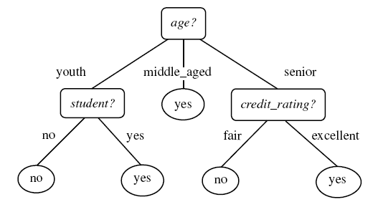
Decision Tree Induction
Decision tree induction is the learning of decision trees from class-labeled training tuples.
A decision tree is a flowchart-like tree structure, where
each internal node (nonleaf node) denotes a test on an attribute,
each branch represents an outcome of the test, and
each leaf node (or terminal node) holds a class label.
The topmost node in a tree is the root node.
Internal nodes are denoted by rectangles, and
Leaf nodes are denoted by ovals.
Intermediate nodes : Attributes
Edges : Attribute value tests
Leaf nodes : Class predictions
Figure : A decision tree for the concept buys computer, each leaf node represents a class :
buys computer = yes or buys computer = no
Example algorithms: ID3, C4.5,CART

Slide 14
Classification
Decision Tree Induction
“How are decision trees used for classification?”
Given a tuple, X, for which the associated class label is unknown, the attribute values of the tuple are tested against the decision tree.
A path is traced from the root to a leaf node, which holds the class prediction for that tuple.
Decision trees can easily be converted to classification rules.

Slide 15
Classification
Why decision tree ?
Why are decision tree classifiers so popular?
The construction of decision tree classifiers does not require any domain knowledge or parameter setting, and therefore is appropriate for exploratory knowledge discovery.
Decision trees can handle multidimensional data.
Their representation of acquired knowledge in tree form is intuitive and generally easy to assimilate by humans.
The learning and classification steps of decision tree induction are simple and fast.
In general, decision tree classifiers have good accuracy.
However, successful use may depend on the data at hand.
15
15

Slide 16
Classification
Decision Tree Induction
During the late 1970s and early 1980s, J. Ross Quinlan, a researcher in machine learning, developed a decision tree algorithm known as ID3 (Iterative Dichotomiser).
In 1984, a group of statisticians (L. Breiman, J. Friedman, R. Olshen, and C. Stone) published the book Classification and Regression Trees (CART), which described the generation of binary decision trees.
ID3 and CART were invented independently of one another at around the same time, yet follow a similar approach for learning decision trees from training tuples.
ID3, C4.5, and CART adopt a greedy (i.e., non-backtracking) approach in which decision trees are constructed in a top-down recursive divide-and-conquer manner.
The training set is recursively partitioned into smaller subsets as the tree is being built.

Slide 17
Decision Tree Induction
Classification
The algorithm is called with three parameters:
D, attribute list, and Attribute selection method.
D as a data partition. Initially, it is the complete set of training tuples and their associated class labels.
The parameter attribute list is a list of attributes describing the tuples.
Attribute selection method specifies a heuristic procedure for selecting the attribute that “best” discriminates the given tuples according to class.
This procedure employs an attribute selection measure such as Information Gain or the Gini index.
Notes:
17

Slide 18
DT: Algorithm
Classification
Let D_{t} be the set of training records that reach a node t
General Procedure:
If D_{t} contains records that belong the same class y_{t}, then t is a leaf node labeled as y_{t}
If D_{t} is an empty set, then t is a leaf node labeled by the default class, y_{d}
If D_{t} contains records that belong to more than one class, use an attribute test to split the data into smaller subsets. Recursively apply the procedure to each subset.
D_{t}
?
Issues
Determine how to split the records
How to specify the attribute test condition?
How to determine the best split?
Determine when to stop splitting
18
Notes:
18

Slide 19
DT: Algorithm
Classification
Algorithm: Generate decision tree. Generate a decision tree from the training tuples of data partition, D.
Input:
Data partition, D, which is a set of training tuples and their associated class labels;
attribute list, the set of candidate attributes;
Attribute selection method, a procedure to determine the splitting criterion that “best” partitions the data tuples into individual classes. This criterion consists of a splitting attribute and, possibly, either a split-point or splitting subset.
Output: A decision tree.
Method:
create a node N;
if tuples in D are all of the same class, C, then
return N as a leaf node labeled with the class C;
…..
19

Slide 20
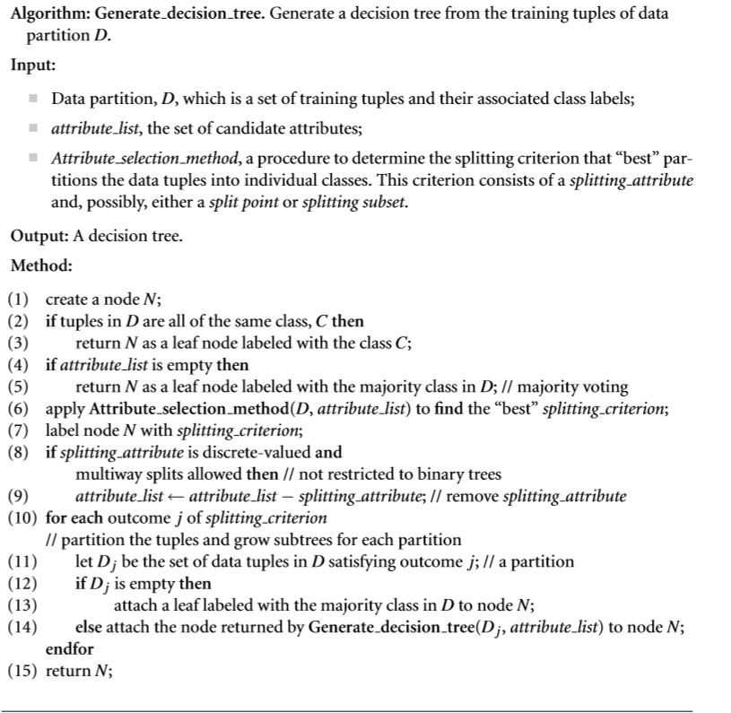
DT: Algorithm

Slide 21
Classification
DT: Algorithm
The recursive partitioning stops only when any one of the following terminating conditions is true:
All the tuples in partition D (represented at node N) belong to the same class (steps 2 and 3).
There are no remaining attributes on which the tuples may be further partitioned (step 4).
In this case, majority voting is employed (step 5). This involves converting node N into a leaf and labeling it with the most common class in D. Alternatively, the class distribution of the node tuples may be stored.
There are no tuples for a given branch, that is, a partition Dj is empty (step 12).
In this case, a leaf is created with the majority class in D (step 13).
21
21

Slide 22
Classification
Attribute Selection Measures
An attribute selection measure is a heuristic for selecting the splitting criterion that “best” separates a given data partition, D, of class-labeled training tuples into individual classes.
The attribute selection measure provides a ranking for each attribute describing the given training tuples. The attribute having the best score for the measure is chosen as the splitting attribute for the given tuples.
Three popular attribute selection measures
information gain, gain ratio, and Gini index
22

Slide 23
Classification
Information Gain
ID3 uses information gain as its attribute selection measure.
This measure is based on pioneering work by Claude Shannon on information theory.
Let node N represent or hold the tuples of partition D.
The attribute with the highest information gain is chosen as the splitting attribute for node N.
This attribute minimizes the information needed to classify the tuples in the resulting partitions and reflects the least randomness or “impurity” in these partitions.
Such an approach minimizes the expected number of tests needed to classify a given tuple and guarantees that a simple tree is found.
23

Slide 24
Classification
Attribute Selection Measures
The notation
Let D, the data partition, be a training set of class-labeled tuples.
Suppose the class label attribute has m distinct values defining m distinct classes, C_{i} (for i= 1, …, m).
Let C_{i,D} be the set of tuples of class Ci in D. Let |D| and |C_{i,D}| denote the number of tuples in D and C_{i,D}, respectively.
24

Slide 25

Classification
Information Gain
The expected information needed to classify a tuple in D is given by
where pi is the nonzero probability that an arbitrary tuple in D belongs to class Ci and is estimated by |C_{i, D}|/ |D|.
A log function to the base 2 is used, because the information is encoded in bits.
Info(D) is just the average amount of information needed to identify the class label of a tuple in D.
Note that, at this point, the information we have is based solely on the proportions of tuples of each class.
Info(D) is also known as the entropy of D.

Slide 26
Classification
Information Gain
Now, suppose we were to partition the tuples in D on some attribute A having v distinct values, {a1, a2, : : : , av}, as observed from the training data.
If A is discrete-valued, these values correspond directly to the v outcomes of a test on A.
Attribute A can be used to split D into v partitions or subsets, {D1, D2, : : : , Dv}, where Dj contains those tuples in D that have outcome aj of A.
These partitions would correspond to the branches grown from node N. Ideally, we would like this partitioning to produce an exact classification of the tuples. That is, we would like for each partition to be pure.
However, it is quite likely that the partitions will be impure (e.g., where a partition may contain a collection of tuples from different classes rather than from a single class).

Slide 27

Classification
Attribute Selection Measures
How much more information would we still need (after the partitioning) to arrive at an exact classification? This amount is measured by
The term |D_{j}|/ |D| acts as the weight of the jth partition.
Info_{A}(D) is the expected information required to classify a tuple from D based on the partitioning by A.
The smaller the expected information (still) required, the greater the purity of the partitions.
Information gain is defined as the difference between the original information
Requirement and the new requirement (i.e., obtained after partitioning on A).
That is, Gain(A) = Info(D) – Info_{A}(D)
In other words, Gain(A) tells us how much would be gained by branching on A.

Slide 28
Attribute Selection Measures
Select the attribute with the highest information gain
Let p_{i} be the probability that an arbitrary tuple in D belongs to class C_{i}, estimated by |C_{i, D}|/|D|
Expected information (entropy) needed to classify a tuple in D:
Information needed (after using A to split D into v partitions) to classify D:
Information gained by branching on attribute A
$$\text{Info}\left(D\right)=−\sum_{i=1}^{m}{p_{i}}{\text{log}}_{2}\left(p_{i}\right)$$
$$\text{Gain}\left(A\right)=\text{Info}\left(D\right)−{\text{Info}}_{A}\left(D\right)$$
28
Notes:
28
I : the expected information needed to classify a given sample
E (entropy) : expected information based on the partitioning into subsets by A

Slide 29
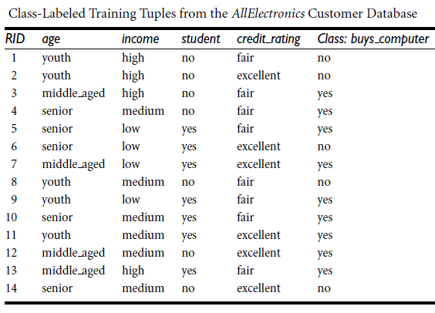

Slide 30
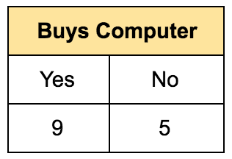

Classification
Example
The class label attribute, buys computer, has two distinct values, namely, {yes, no}; therefore, there are two distinct classes (i.e., m = 2).
Let class C1 correspond to yes and class C2 correspond to no.
There are nine tuples of class yes and five tuples of class no.
A (root) node N is created for the tuples in D.
To find the splitting criterion for these tuples, we must compute the information gain of each attribute.
We first compute the expected information needed to classify a tuple in D

Slide 31
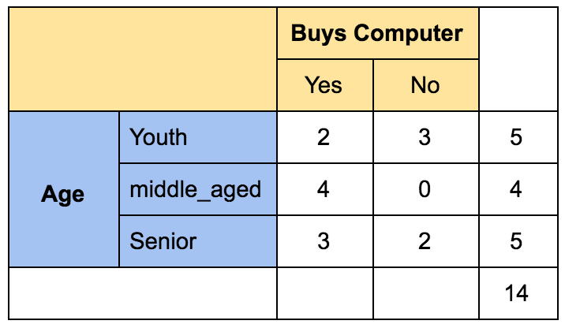



Classification
Example
Next, we need to compute the expected information requirement for each attribute.
Let’s start with the attribute age.
We need to look at the distribution of yes and no tuples for each category of age.
For the age
category “youth,” there are two yes tuples and three no tuples.
category “middle aged,” there are four yes tuples and zero no tuples.
category “senior,” there are three yes tuples and two no tuples.
Compute the expected information needed to classify a tuple in D if the tuples are partitioned according to age is

Slide 32
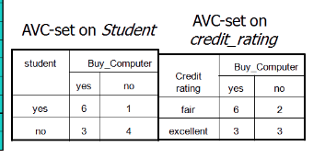
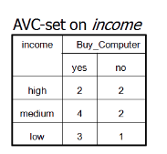

Slide 33

Classification
Example
Hence, the gain in information from such a partitioning would be
Gain(age) = Info(D)- Info_{age}(D)
= 0.940- 0.694
= 0.246 bits.

Slide 34
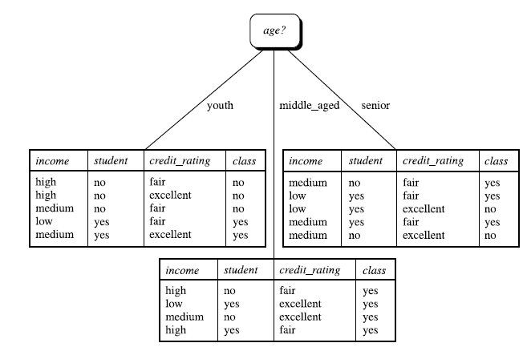

Slide 36
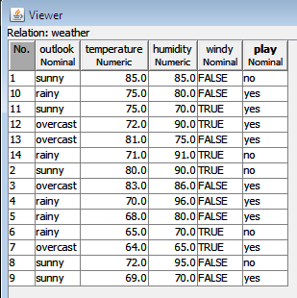
36

Slide 37
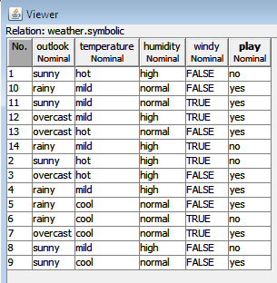
37

Slide 38
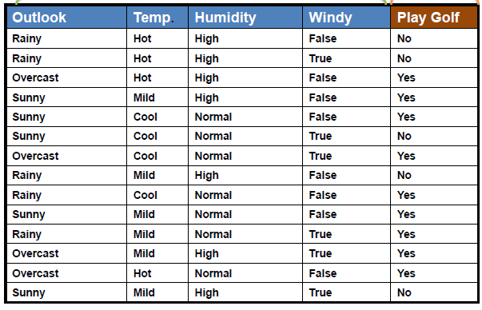
38

Slide 39
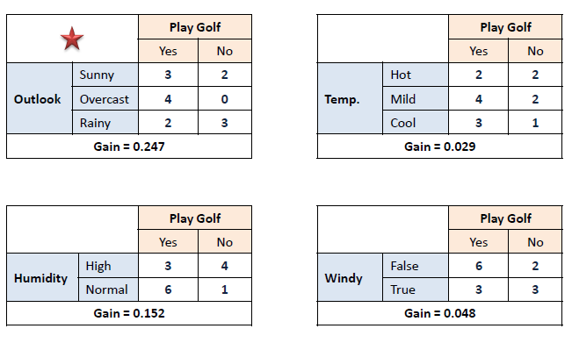
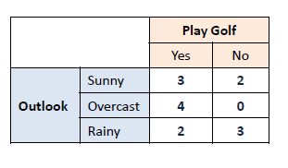
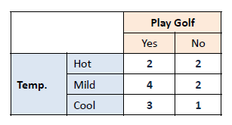
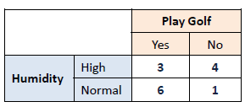
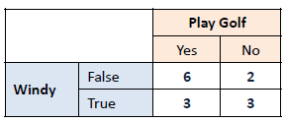
39

Slide 40
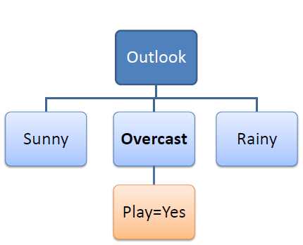
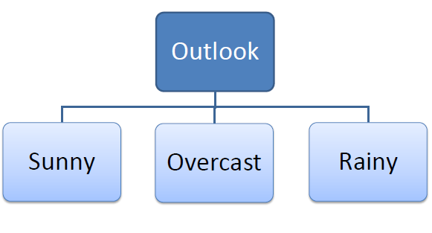
40

Slide 41
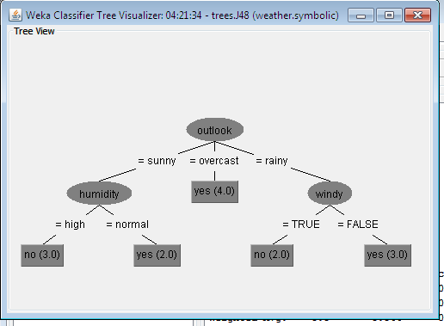
41

Slide 42
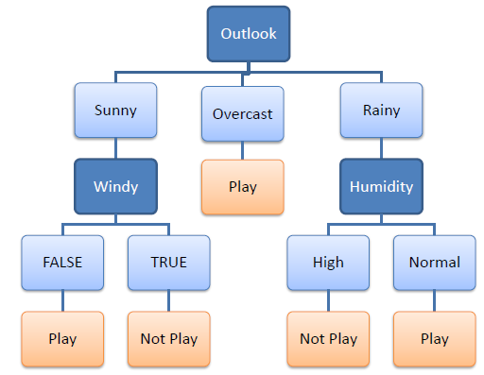
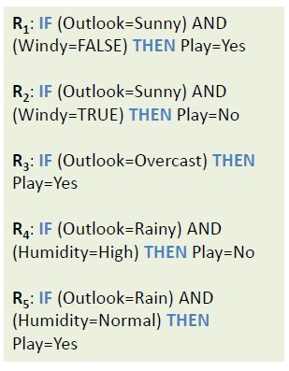
42

Slide 43
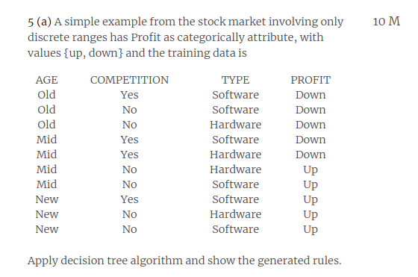

Slide 44
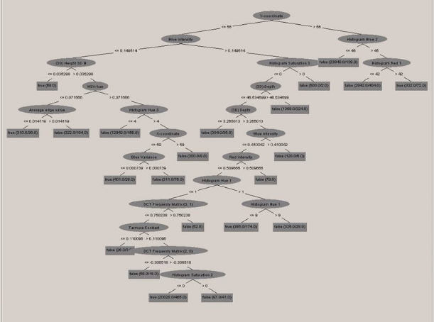
Classification
DT

Slide 45
Classification
Pruning Trees
The main drawback of DT is overfitting. The generated tree may overfit the training data 1. Too many branches,some may reflect anamolies due to noise and outlier 2.poor accuracy for unseen samples Two approches to avoid overfitting 1. Prepruning: The incorrect branches are discarded by halting tree construction. 1.Do not split a node if this would result in the goodness measure falling below a threshold value, otherwise it is grown 2.Prepruning:Early stopping 2.Postpruning:Grow the whole tree then prune subtrees which overfit on the pruning set Prepruning is faster, postpruning is more accurate (requires a separate pruning set) Most popular test: chi-squared test ID3 used chi-squared test in addition to information gain Only statistically significant attributes were allowed to be selected by information gain procedure

Slide 46
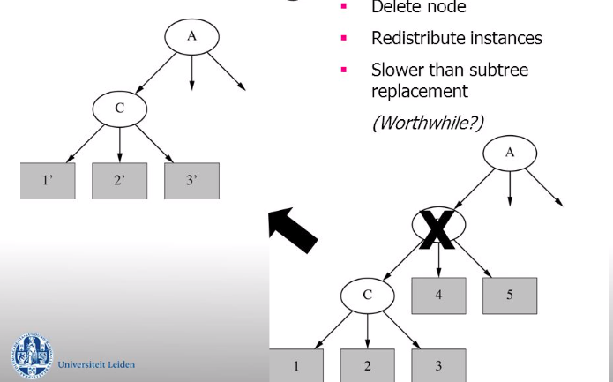
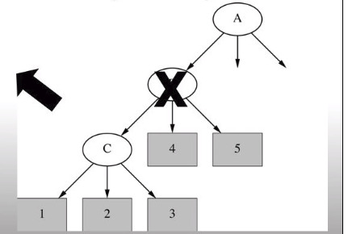
Classification
Pruning Trees

Slide 47
Naïve Bayes

Slide 48
Classification
Basic Concepts
Bayesian classifiers are statistical classifiers.
They can predict class membership probabilities such as the probability that a given tuple belongs to a particular class.
Bayesian classification is based on Bayes’ theorem.
Naive Bayesian classifiers assume that the effect of an attribute value on a given class is independent of the values of the other attributes.
This assumption is called class conditional independence. It is made to simplify the computations involved and, in this sense, is considered “naive.”
Notes:
Figure: A system is described by the partial descriptions in terms of the models (formal or semi formal).
From model, either execution or by other means abstract test cases can be derived. Abstract test cases are portable to any implementation platform to generate concrete test cases.
Concrete test cases are used to test implementation of the systems.
Model based testing promotes design driven testing.
This leads to early planning and design of test cases in the development cycle.
As concurrency is the property of he system, concurrency testing may be planned and designed early in the development cycle with the help of models.
UML designs are one of the source of concurrency information at the design level.
With recent trend towards Model Driven Architecture (MDA) \cite{Poole2001}, the choice of UML models is natural source for concurrency information at the design level.
Image source -- http://en.wikipedia.org/wiki/Model-based_testing
48

Slide 49

Classification
Bayes’ Theorem
Let X be a data tuple.
In Bayesian terms, X is considered “evidence.”
As usual, it is described by measurements made on a set of n attributes.
Let H be some hypothesis such as that the data tuple X belongs to a specified class C.
For classification problems, we want to determine P(H|X), the probability that the hypothesis H holds given the “evidence” or observed data tuple X.
In other words, we are looking for the probability that tuple X belongs to class C, given that we know the attribute description of X.
Notes:
49

Slide 50
Classification
Bayes’ Theorem
P(H|X) is the posterior probability, or a posteriori probability, of H conditioned on X.
For example, suppose our world of data tuples is confined to customers described by the attributes age and income, respectively, and that X is a 35-year-old customer with an income of $40,000.
Suppose that H is the hypothesis that our customer will buy a computer.
Then P(H|X) reflects the probability that customer X will buy a computer given that we know the customer’s age and income.
Notes:
Concurrent states : http://twu.seanho.com/11spr/cmpt166/uml/state.html
Concurrent activity : http://twu.seanho.com/11spr/cmpt166/uml/#sequence-diagrams
50

Slide 51
Classification
Bayes’ Theorem
In contrast, P(H) is the prior probability, or a priori probability, of H.
For our example, this is the probability that any given customer will buy a computer, regardless of age, income, or any other information, for that matter.
The posterior probability, P(H|X), is based on more information (e.g., customer information) than the prior probability, P(H), which is independent of X.
Similarly, P(X|H) is the posterior probability of X conditioned on H.
That is, it is the probability that a customer, X, is 35 years old and earns $40,000, given that we know the customer will buy a computer.
P(X) is the prior probability of X.
Using our example, it is the probability that a person from our set of customers is 35 years old and earns $40,000.

Slide 52

Classification
Naive Bayesian Classification
The naïve Bayesian classifier, or simple Bayesian classifier, works as follows:
Let D be a training set of tuples and their associated class labels. As usual, each tuple is represented by an n-dimensional attribute vector, X ={ x1, x2, : : : , xn}, depicting n measurements made on the tuple from n attributes, respectively, A1, A2, : : : , An.
Suppose that there are m classes, C1, C2, : : : , Cm. Given a tuple, X, the classifier will predict that X belongs to the class having the highest posterior probability, conditioned on X. That is, the na¨ıve Bayesian classifier predicts that tuple X belongs to the class Ci if and only if

Slide 53

Classification
Naïve Bayesian Classification
2. Thus, we maximize P(Ci|X). The class Ci for which P(Ci|X) is maximized is called the maximum posteriori hypothesis. By Bayes’ theorem
3. As P(X) is constant for all classes, only P(X|Ci)/P(Ci) needs to be maximized. If the class prior probabilities are not known, then it is commonly assumed that the classes are equally likely, that is, P(C1)= P(C2) =, …, = P(Cm), and we would therefore maximize P(X|Ci).
53
53

Slide 54
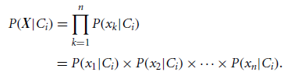
Classification
Naïve Bayesian Classification
Given data sets with many attributes, it would be extremely computationally expensive to compute P(X|Ci). To reduce computation in evaluating P(X|Ci), the na¨ıve assumption of class-conditional independence is made. This presumes that the attributes’ values are conditionally independent of one another, given the class label of the tuple (i.e., that there are no dependence relationships among the attributes). Thus,
54

Slide 55
Classification
Naïve Bayesian Classification
To predict the class label of X, P(X|Ci)P(Ci) is evaluated for each class Ci . The classifier predicts that the class label of tuple X is the class Ci if and only if
In other words, the predicted class label is the class Ci for which P(X|Ci)/P(Ci) is the maximum.
55

Slide 56
Naïve Bayesian Classification

Slide 57
57

Slide 58
Classification
Example
The data tuples are described by the attributes age, income, student, and credit rating.
The class label attribute, buys computer, has two distinct values namely, {yes, no}).
Let C1 correspond to the class buys computer D yes and C2 correspond to buys computer D no. The tuple we wish to classify is
58

Slide 59



Classification
Example
We need to maximize P(X|Ci)P(Ci), for i=1, 2.
P(Ci), the prior probability of each class, can be computed based on the training tuples:
59

Slide 60

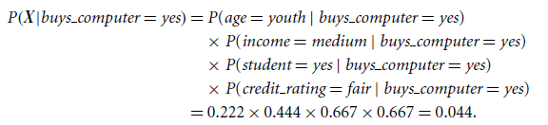

Classification
Example
Using these probabilities, we obtain
Similarly,
To find the class, Ci , that maximizes P(X|Ci)P(Ci), we compute
60

Slide 61
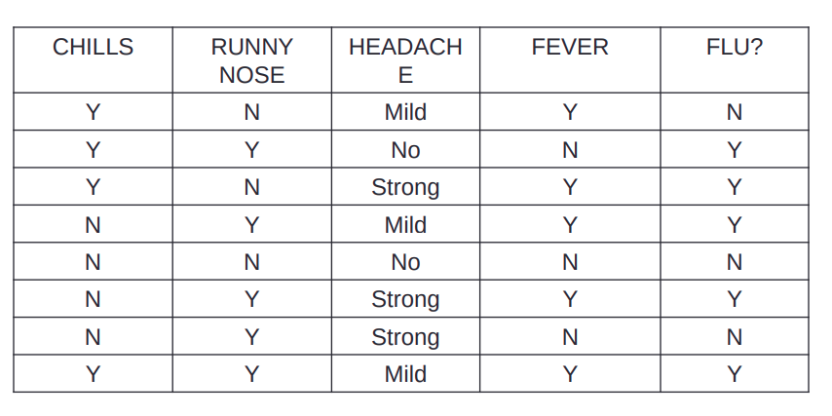
Example
Data sample X = (chills=Y, runnynose=N,
headache=mild, fever=Y)
For given data sample find whether the person has flu or no using Naive Bayesian classification.
61
Notes:
61

Slide 62
Example
C1 :Flu = “yes” C2 : Flu = “no”
The total number of records in the table are 8.
P(Flu = “yes”) = 5/8 = 0.62
P(Flu = “no”) = 3/10= 0.37
P(Ci) =
Compute P(X|Ci) for each class
P(chills=“Y” | Flu = “yes”) = 3/5 = 0.6
P(chills =“Y” |Flu = “no”) = 1/3=0.33
P(runny nose=“N” | Flu = “yes”) = 1/5 = 0.2
P(runny nose=“N” |Flu = “no”) =2/3 = 0.66
P(headache=“mild” | Flu = “yes”) = 2/5 = 0.4 P(headache=“mild” |Flu = “no”) = 1/3 = 0.33
P(fever=“Y” | Flu = “yes”)= 4/5= 0.8
P(fever=“Y” |Flu = “no”) = 1/3=0.33
62
Notes:
62

Slide 63
Example
Multiplying all the probabilities with yes values and no values from
above separately.
P(X|Ci) :
P(X|Flu= “yes”)
= 0.6 x 0.4 x 0.2 x 0.8
= 0.0384
P(X|Flu = “no”)
= 0.33x 0.66 x 0.33 x 0.33
= 0.024
Now, multiply these probabilities with the above calculated P(Ci)
P(X|Ci)*P(Ci) :
P(X|Flu = “yes”) * P(Flu = “yes”) = 0.0384 x 0.62=0.023
P(X|Flu = “no”) * P(Flu = “no”) = 0.024 x0.37=0.0088
The maximum value is 0.023.
Therefore, X belongs to class (“Flu=yes”)
63
Notes:
63

Slide 64
Example
PATIENT | DISEASE | SUGAR LEVEL | SURVIVAL CHANCES
Small | Serious | High | Yes
Medium | Normal | Low | Yes
Senior | Lifetime | Normal | Yes
Small | Lifetime | High | No
Small | Normal | High | Yes
Senior | Serious | Normal | No
Medium | Serious | Low | Yes
Senior | Normal | Low | No
Medium | Lifetime | Normal | Yes
Medium | Serious | High | No
Senior | Normal | Low | No
Data sample X = (age=senior, disease=normal, sugar
level=normal)
64
Notes:
64

Slide 65
Introduction to Regression
The Pearson correlation measures the degree to which a set of data points form a straight line relationship.
Regression is a statistical procedure that determines the equation for the straight line that best fits a specific set of data.
65
Notes:
65

Slide 66
Introduction to Regression
Any straight line can be represented by an equation of the form Y = bX + a, where b and a are constants.
The value of b is called the slope constant and determines the direction and degree to which the line is tilted.
The value of a is called the Y-intercept and determines the point where the line crosses the Y-axis.
66
Notes:
66

Slide 67
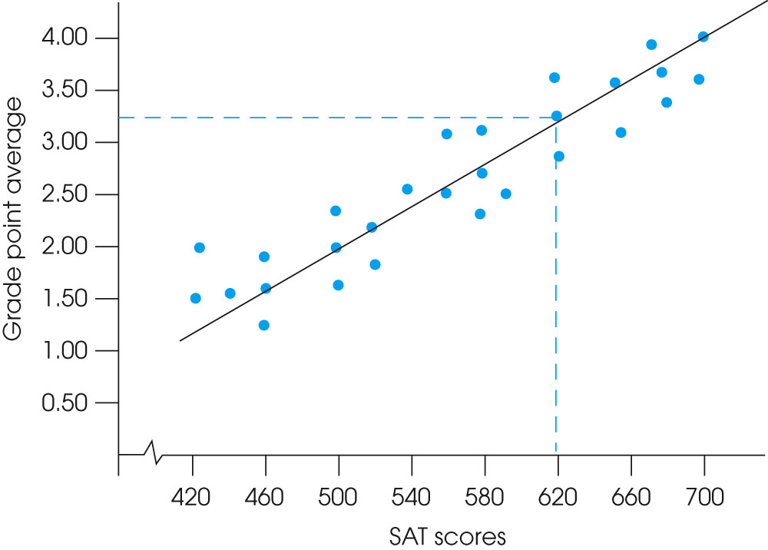
Introduction to Regression
67
Notes:
67

Slide 68
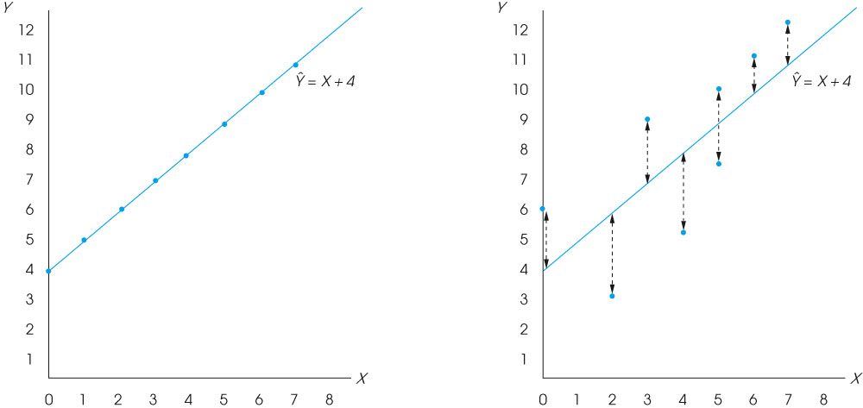
Introduction to Regression
68
Notes:
68

Slide 69
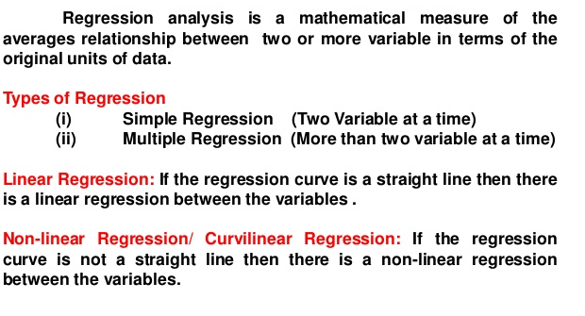
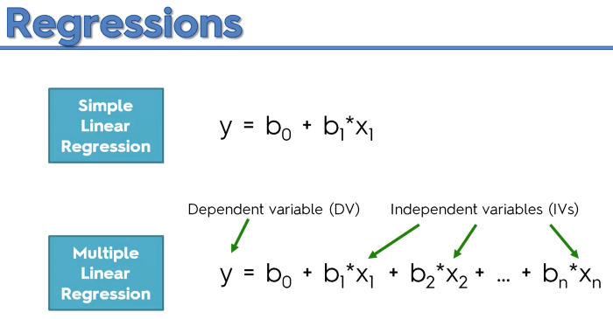
Introduction to Regression
69
Notes:
69

Slide 70
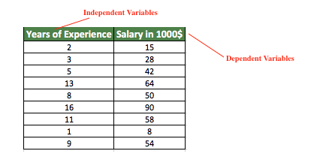

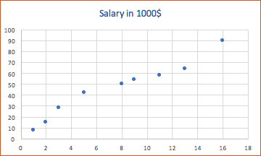
Introduction to Regression
Y = mx + b
70
70
Notes:
70

Slide 71

Introduction to Regression
Regression Analysis
Years of Experience xi | Salary (in 1000$)yi
2 | 15 | -5.56 | -30.44 | 169.25 | 30.91
3 | 28 | -4.56 | -17.44 | 79.53 | 20.79
5 | 42 | -2.56 | -3.44 | 8.81 | 6.55
13 | 64 | 5.44 | 18.56 | 100.97 | 29.59
8 | 50 | 0.44 | 4.56 | 2.01 | 0.19
16 | 90 | 8.44 | 44.56 | 376.09 | 71.23
11 | 58 | 3.44 | 12.56 | 43.21 | 11.83
1 | 8 | -6.56 | -37.44 | 245.61 | 43.03
9 | 54 | 1.44 | 8.56 | 12.33 | 2.07
7.56 | 45.44 |  |  | 1037.81 | 216.19
71
71
Notes:
71

Slide 72
Introduction to Regression
m = 1037.8 / 216.19
m = 4.80
b = 45.44 - 4.80 * 7.56 = 9.15
Hence, y = mx + b → 4.80x + 9.15
y = 4.80x + 9.15
72
Notes:
72

Slide 73
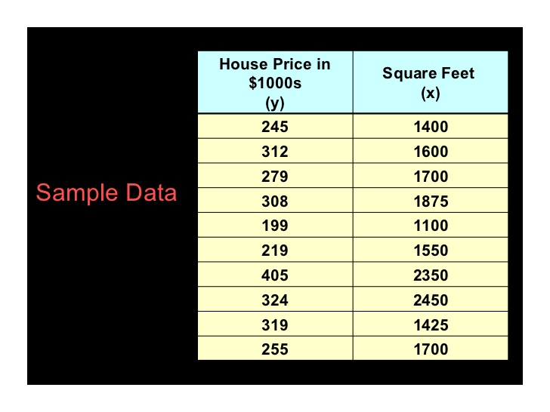

Regression Analysis
73
73
Notes:
73

Slide 74
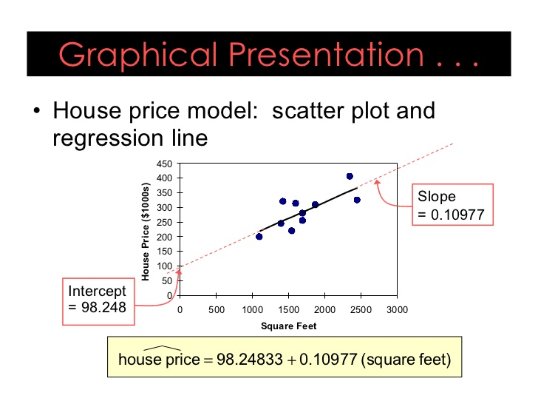
Regression Analysis
74
Notes:
74

Slide 75
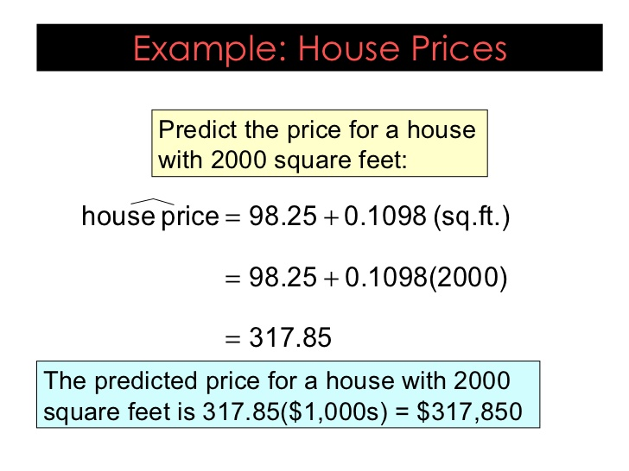
Regression Analysis
75
Notes:
75

Slide 76
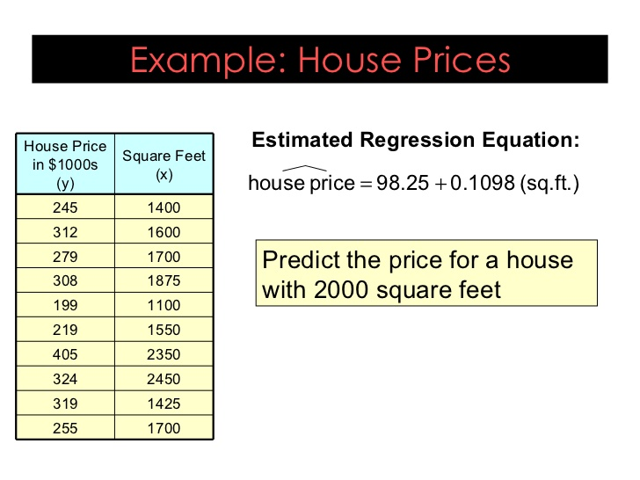
Regression Analysis
76
Notes:
76

Slide 77
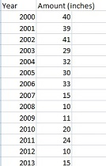
Regression Analysis
Predict how much snow will fall 2017
77
Notes:
77

Slide 78
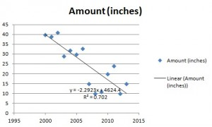
Regression Analysis
y = -2.2923x + 4624.4
y = 2.2923(2017) + 4624.4 = 0.8 inches.
78
78
Notes:
78

Slide 79
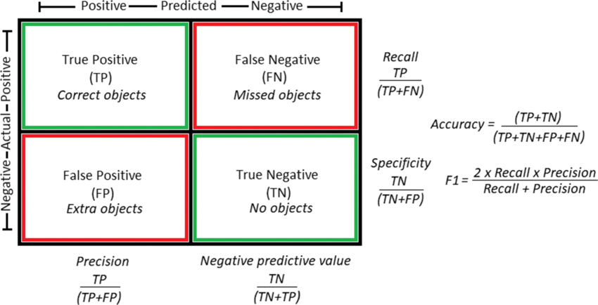
Confusion matrix and performance evaluation measures

Slide 80
Confusion matrix and performance evaluation measures
Recall: The ability of a model to find all the relevant cases within a data set. Mathematically, we define recall as the number of true positives divided by the number of true positives plus the number of false negatives.
Precision: The ability of a classification model to identify only the relevant data points. Mathematically, precision the number of true positives divided by the number of true positives plus the number of false positives.

Slide 81
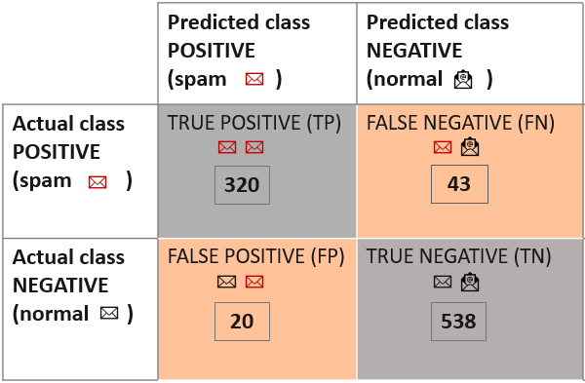
classification model predicting emails as “spam” or “normal”

Slide 82
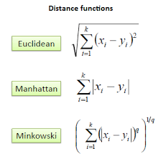
Distance function
For p=2, we get the L2 form, which is Manhattan Distance
p=1, we get the L1 form, which is Euclidean Distance

Slide 83
Euclidean Distance
Calculate the Distance Matrix
Point | X | Y
P1 | 0 | 2
P2 | 2 | 0
P3 | 3 | 1
P4 | 5 | 1

Slide 84
Distance function
Given two objects represented by the tuples ( 15, 7, 24, 21) and (12, 0, 16, 10);
Compute the Euclidean distance between the two objects.
(b) Compute the Manhattan distance between the two objects
(c) Compute the Minkowski distance between the two objects, using h=3.
(d) Compute the supremum distance between the two objects

Slide 85
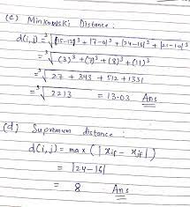

Slide 86
Books
Text Books:
1. Han, Kamber, "Data Mining Concepts and Techniques", Morgan Kaufmann 3nd Edition
2. P. N. Tan, M. Steinbach, Vipin Kumar, “Introduction to Data Mining”, Pearson Education
3. M. H. Dunham, Data Mining Techniques and Algorithms”, Prentice Hall-2000.
86

